Slide 1
The Impact of Bias in AI Technology: An AI Ethical Challenges and Analysis
Xingyu LiAn
Zirui Qiao
Zhenyu Zhang

Slide 2
Overview
Imbalance in training data will most definitely result in bias in the model performance. Such bias may mostly affect the rights of the underrepresented social groups.
The current legislations are weakness in mitigating the ethical concerns and risks associated with facial recognition technology.
There should have more accurate and strict regulation to solve the bias in Facial Recognition Technology.

Slide 3

Implication of Bias in AI
Example of Bias in AI:
Detailed studies by researchers at MIT and Microsoft Research and at the US National Institute of Standards and Technology (NIST) identified persistent inaccuracies in algorithms that were designed to detect and/or identify faces when applied to people of color.
Current Solution:
The algorithms were also less accurate for women than for men, with the largest errors, up to 35 percent, arising for female faces of color, according to the MIT/Microsoft study (Perkowitz, 2021).
Potential Effort:
The legislations should emphasize the demographic diversity in the development of these algorithms, as historically, datasets have lacked representation from nonwhite populations, leading to inherent biases.

Slide 4

Biased Dataset
The dataset we used is “lfw_allnames.csv file” from , Labeled Faces in the Wild (LFW). The csv file lists the names associated with each face in the datasets, along with the number of images available for individual.
And We will see that there exist a huge bias as a name “George Bush” in this dataset appear too many times which is bias between people with more picture and less picture.

Slide 5
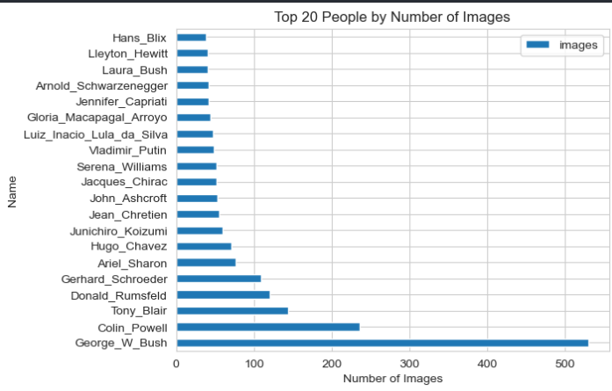
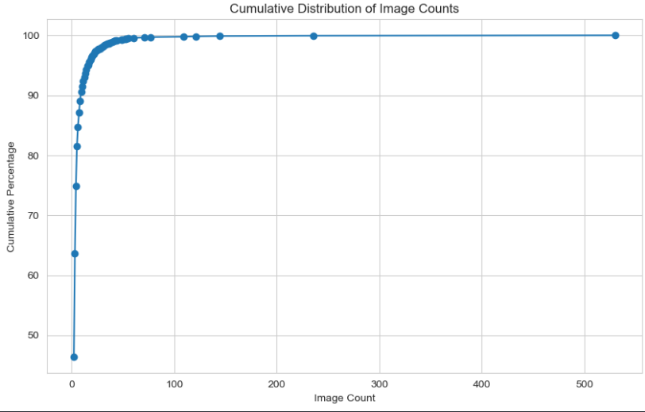
Analysis Biased Dataset

Slide 6
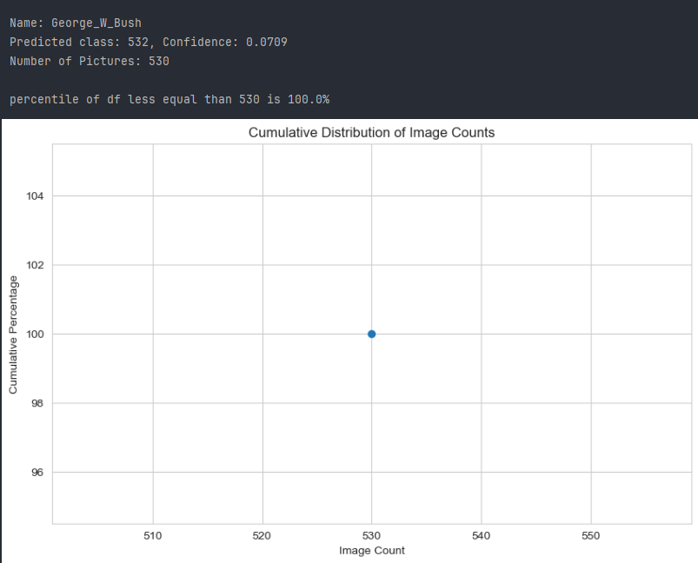
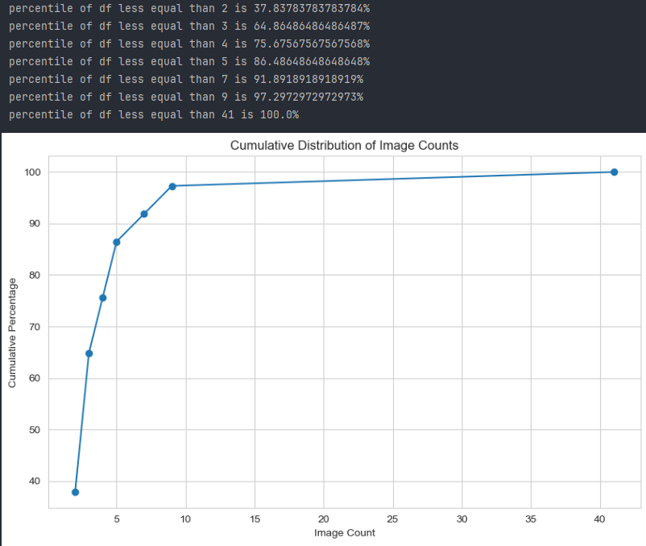
Cumulative Distribution Graph CNN (Left: Biased Right: Unbiased)

Slide 7
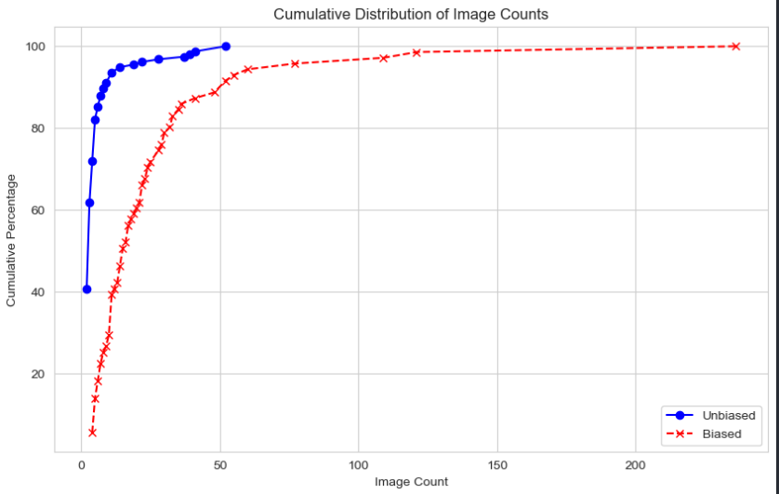
Cumulative Distribution Graph ResNet-34
Original Dataset:
The closest percentile to 90% is 9 (90.6%)
Unbiased Prediction:
the closest percentile to 90% is also 9 (89.0%)
Biased Prediction:
the closest percentile to 90% is 44 (89.5%)

Slide 8
EU GDPR
Three principles of legality, fairness, and transparency: Data information related to the individual data subject should be processed in a legal, fair, and transparent manner.
Data collection should have a clear purpose: Personal information collection should have a specific, clear, and legal purpose, and any method that is inconsistent with the above purposes will no longer allow the data to be processed.
Minimization principle of data collection: Personal data collection should be limited to all necessary data related to the purpose of data processing.
Accuracy: Personal data should be accurate and, if necessary, kept as up to date as possible.

Slide 9
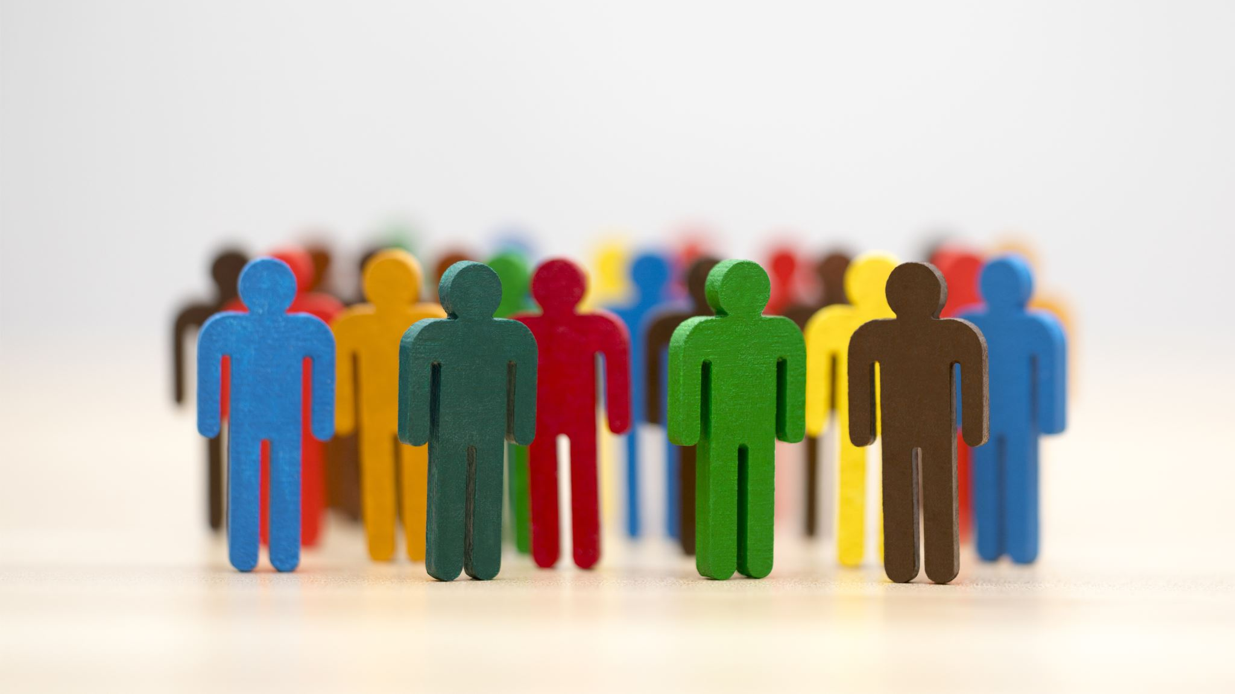
U.S. CCPA
Customer’s Right:
Right to know: Consumers should be informed about what personal information an organization collects about them and how it is used.
Right to erasure: With some exceptions, consumers can have information collected about them deleted.
Right to Opt-Out: Consumers can prevent the sale of their information to third parties.
Right not to discriminate: Organizations cannot treat users differently for exercising their CCPA rights.

Slide 10

China PIPL
Principle of Processing Data:
Legal, fair, necessary, and good faith. PIPL Article 5.
Purpose limitation and data minimization. PIPL Article 6.
Open and transparent. PIPL Article 7.
Accuracy and completeness. PIPL Article 8.
Safety and Accountability. PIPL Article 9.
Limited Data Retention. PIPL Article 19.

Slide 11
Current and Potential Solution
Example:
The Robert Williams case of 2020, where a man was arrested after Detroit Police’s facial recognition application wrongfully identified him as the mugger they were searching for.
Solution:
Current:
Meanwhile, local governments of Somerville, Massachusetts, and of Oakland and San Francisco, California, have prohibited the use of FRT in the police departments (Perkowitz, 2021).
Potential:
More accurate and strict standard that can be put into dataset.
Check unbalanced dataset which has larger possibility of bias problem.
Establish mechanisms of reporting bias and assessing accountability

Slide 12
References
ACLU. (2022, May 9). In Big Win, Settlement Ensures Clearview AI Complies with Groundbreaking Illinois Biometric Privacy Law. Retrieved from https://www.aclu.org/press-releases/big-win-settlement-ensures-clearview-ai-complies-with-groundbreaking-illinois
Agnė Limantė. 2023. Bias in Facial Recognition Technologies Used by Law Enforcement: Understanding the Causes and Searching for a Way Out, Nordic Journal of Human Rights, https://doi.org/10.1080/18918131.2023.2277581
Almeida, D., Shmarko, K., & Lomas, E. (2022). The ethics of facial recognition technologies, surveillance, and accountability in an age of artificial intelligence: A comparative analysis of US, EU, and UK regulatory frameworks. AI and Ethics, 2, 377–387. https://doi.org/10.1007/s43681-021-00077-w
Baik, Jeeyun Sophia. 2020. Data Privacy Against Innovation or Against Discrimination?: The Case of the California Consumer Privacy Act (CCPA). Telematics and Informatics, 52. https://doi.10.1016/j.tele.2020.101431, Available at SSRN: https://ssrn.com/abstract=3624850
California Consumer Privacy Act (CCPA). 2018. Retrieved from https://oag.ca.gov/privacy/ccpa#sectiong
Calzada I. 2022. Citizens’ Data Privacy in China: The State of the Art of the Personal Information Protection Law (PIPL). Smart Cities. 2022; 5(3):1129-1150. https://doi.org/10.3390/smartcities5030057
Christina Tikkinen-Piri, Anna Rohunen, Jouni Markkula. 2018. EU General Data Protection Regulation: Changes and implications for personal data collecting companies. Computer Law & Security Review, Volume 34, Issue 1, 134-153, https://doi.org/10.1016/j.clsr.2017.05.015.
Labelled Faces in the Wild (LFW) datasets. (2018, May 17). https://www.kaggle.com/datasets/jessicali9530/lfw-dataset
Perkowitz, S. (2021). The Bias in the Machine: Facial Recognition Technology and Racial Disparities. MIT Case Studies in Social and Ethical Responsibilities of Computing. https://doi.org/10.21428/2c646de5.62272586

Slide 13
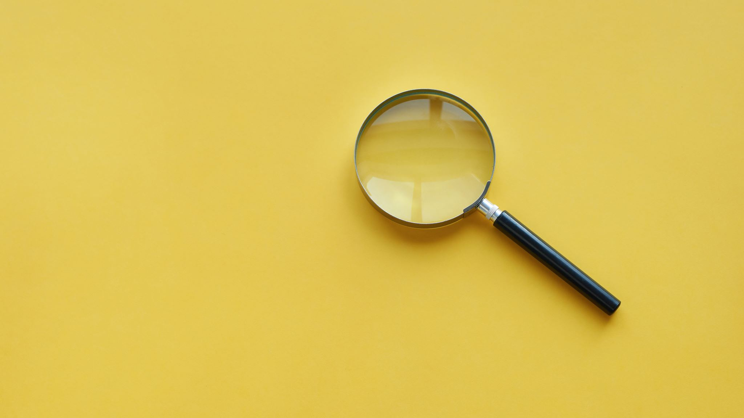
Thank you

